Slide 1

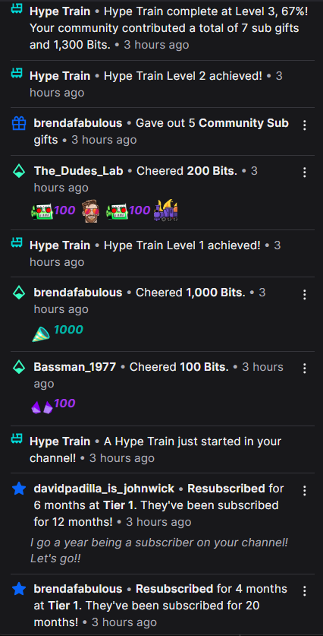
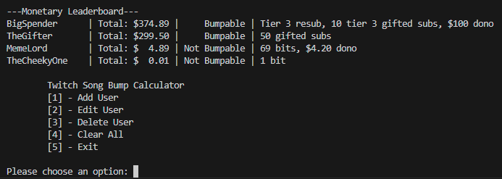
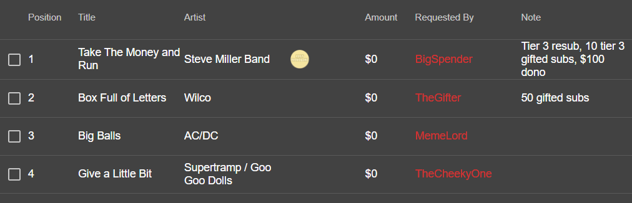

Twitch Song Bump Calculator
Your helpful buddy during raid trains – Made by Abby Chesnut
Doing math during streams can be hectic.
2 gifted subs, $5 dono, 500 bits, tier 2 or higher resub gets you a bumped song request, but how do you keep track who has donated what?
Can easily add/edit users and amounts
Adds it all up, sorts by largest, lets you know if it meets the priority threshold, and gives you output to copy into the streamer songlist!

